Slide 1
Stationary Models Chapter 6
CS 637, St. Elizabeth's University, Fall 2021

Slide 2
Stationary Models
With regard to regression, we do typically see some element of correlation within the residuals
This correlation is not accounted for in regression models
Stationary models can be introduced to compliment a regression model
Models that may be suitable for residual series that contain no obvious trends or seasonal cycles

Slide 3
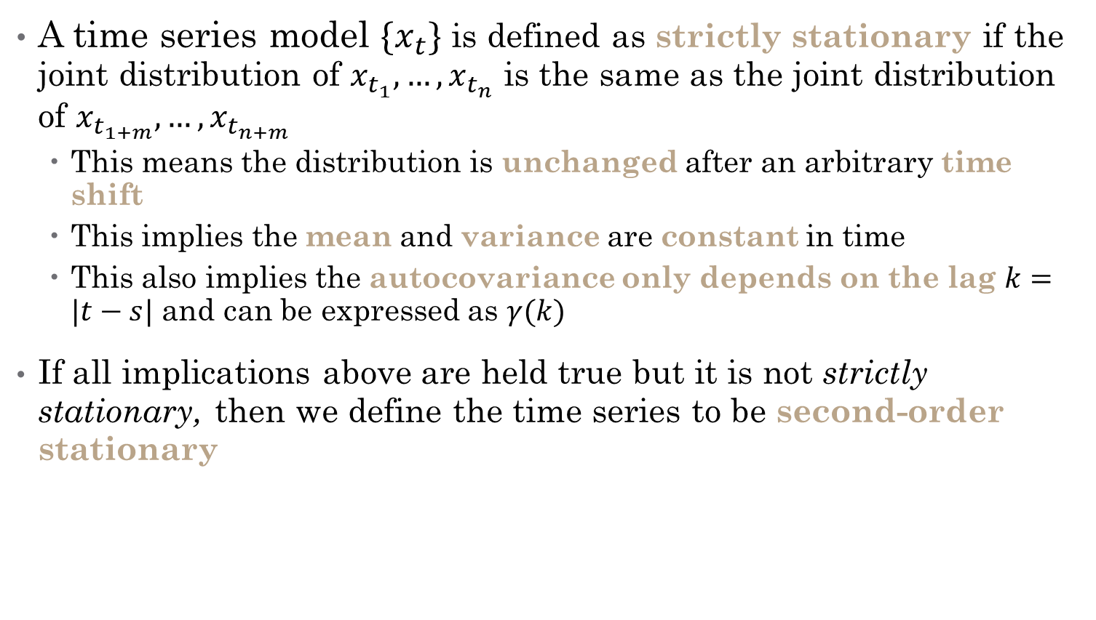
Types of Stationary Models
A time series model $\{x_{t}\}$ is defined as strictly stationary if the joint distribution of $x_{t_{1}},…,x_{t_{n}}$ is the same as the joint distribution of $x_{t_{1+m}},…,x_{t_{n+m}}$
This means the distribution is unchanged after an arbitrary time shift
This implies the mean and variance are constant in time
This also implies the autocovariance only depends on the lag $k=|t−s|$ and can be expressed as $γ(k)$
If all implications above are held true but it is not strictly stationary, then we define the time series to be second-order stationary

Slide 4


Types of Stationary Models
If we wish to apply stationary models, then we first must determine if the time series is stationary
We determine if there is a trend or seasonal effect and remove them
It is often reasonable to treat the time series of residuals as a realization of a stationary error series

Slide 5
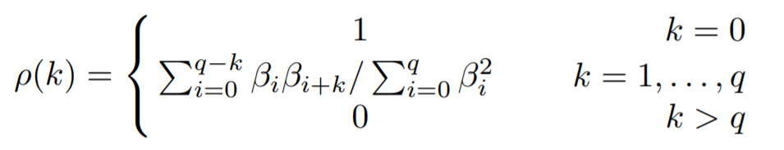
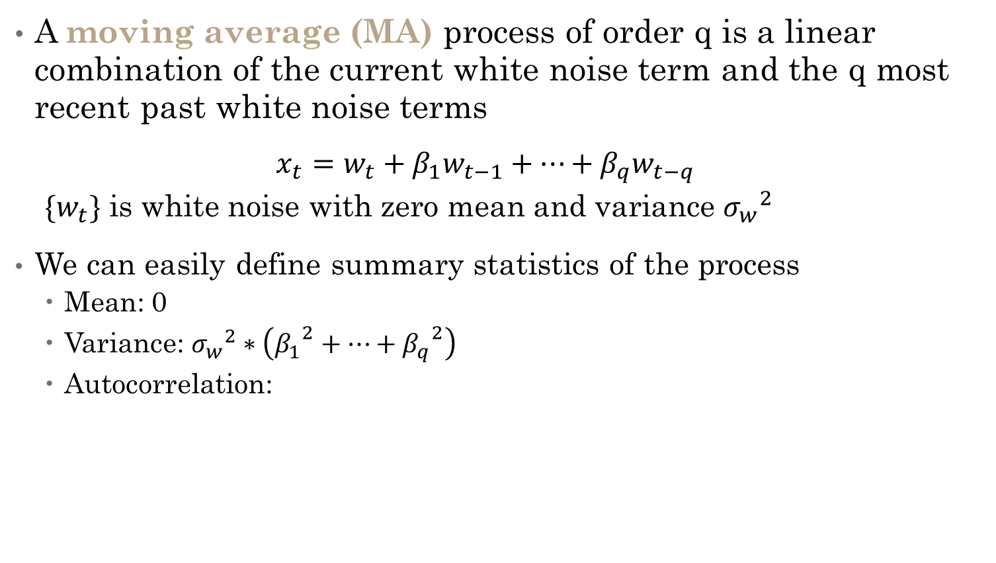
Moving Average Models
A moving average (MA) process of order q is a linear combination of the current white noise term and the q most recent past white noise terms
$$x_{t}=w_{t}+β_{1}w_{t−1}+…+β_{q}w_{t−q}$$
${\{w}_{t}\}$ is white noise with zero mean and variance ${σ_{w}}^{2}$
We can easily define summary statistics of the process
Mean: 0
Variance: ${σ_{w}}^{2}∗\left({β_{1}}^{2}+…+{β_{q}}^{2}\right)$
Autocorrelation:

Slide 6
Lecture 6.RMarkdown
Stationary Models

Slide 7
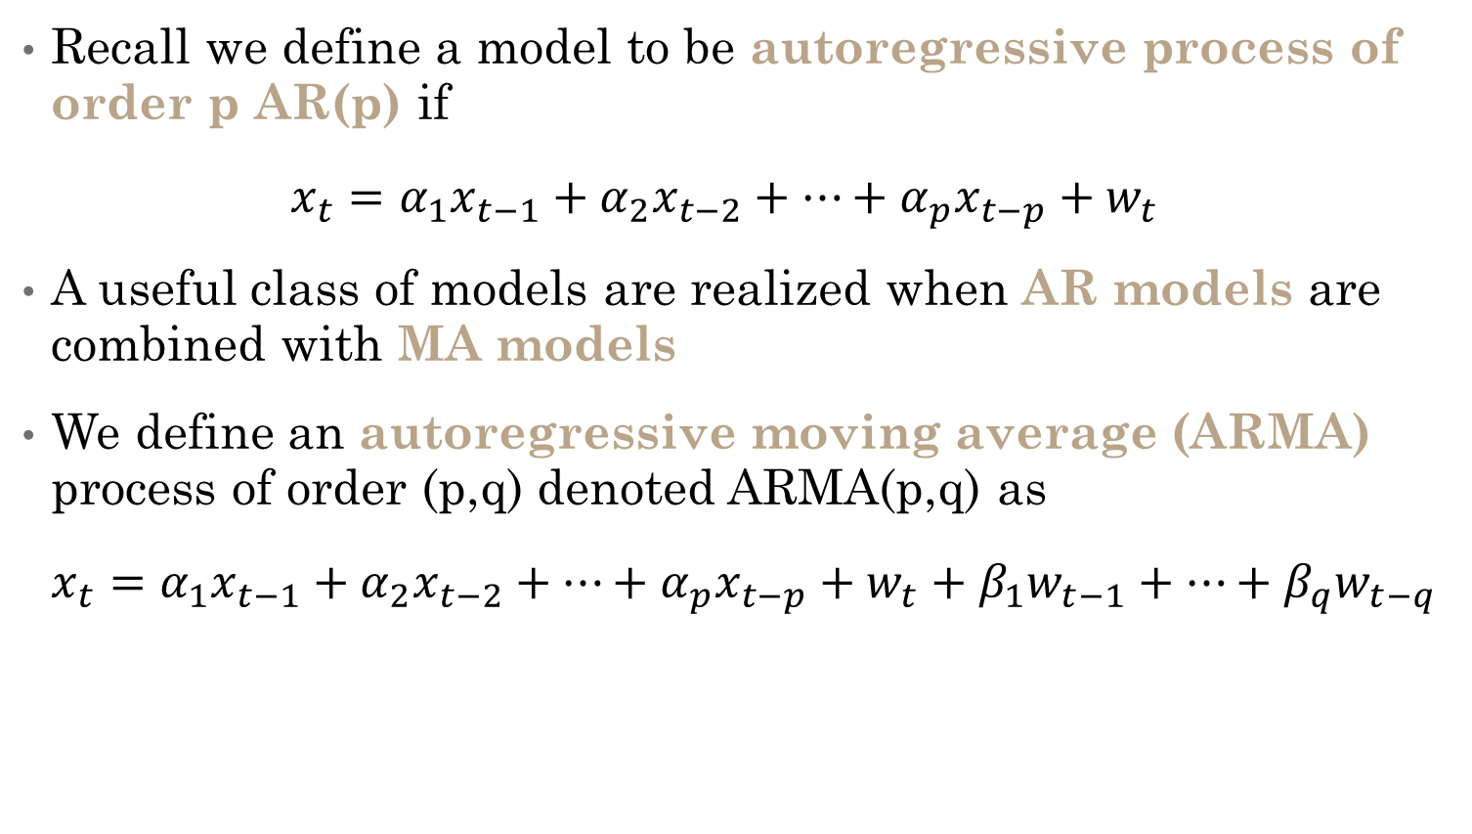
ARMA Mixed Model Process
Recall we define a model to be autoregressive process of order p AR(p) if $x_{t}=α_{1}x_{t−1}+α_{2}x_{t−2}+…+α_{p}x_{t−p}+w_{t}$
A useful class of models are realized when AR models are combined with MA models
We define an autoregressive moving average (ARMA) process of order (p,q) denoted ARMA(p,q) as $x_{t}=α_{1}x_{t−1}+α_{2}x_{t−2}+…+α_{p}x_{t−p}+w_{t}+β_{1}w_{t−1}+…+β_{q}w_{t−q}$

Slide 8
Lecture 6.RMarkdown
Stationary Models

Slide 9
Non-Stationary Models Chapter 7
CS 637, St. Elizabeth's University, Fall 2021

Slide 10
Non-Stationary Models
Many models are non-stationary due to trends or seasonal effects
Remember that many non-stationary models (i.e. random walks) can be transformed to stationary models via first-order differencing
Since first-order differencing requires us to derive (or “integrate”) those differences to recover the original model, we call process Autoregressive Integrated Moving Average or ARIMA
We can build ARIMA models with seasonal terms as well, called SARIMA

Slide 11
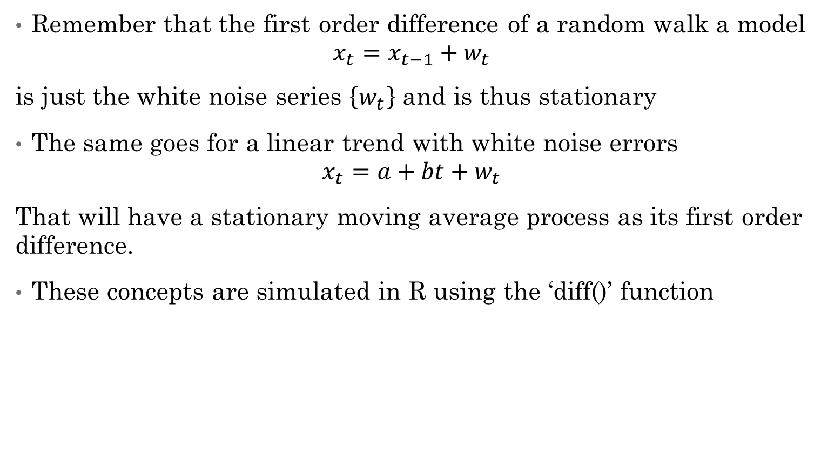
Non Seasonal ARIMA Models
Remember that the first order difference of a random walk a model $x_{t}=x_{t−1}+w_{t}$
is just the white noise series $\left\{w_{t}\right\}$ and is thus stationary
The same goes for a linear trend with white noise errors $x_{t}=a+bt+w_{t}$
That will have a stationary moving average process as its first order difference.
These concepts are simulated in R using the ‘diff()’ function

Slide 12

Non Seasonal ARIMA Models
A series $\left\{x_{t}\right\}$ is integrated of order d if the dth difference of $\left\{x_{t}\right\}$ is white noise $\left\{w_{t}\right\}$
The random walk is a special case of I(1)
Thus, we say a time series $\left\{x_{t}\right\}$ follows an ARIMA(p,d,q) process if the dth difference of $\left\{x_{t}\right\}$ are an ARMA(p,q) process

Slide 13
Lecture 6.RMarkdown
Non-Stationary Model

Slide 14
Seasonal ARIMA Models
A Seasonal ARIMA model uses differencing at a lag equal to the number of seasons, s, to remove seasonal effects.
Seasonal ARIMA models can potentially have a large number of parameters and combinations of terms.
Therefore, it is appropriate to try out a wide range of models when fitting to data and to choose a best-fitting model using an appropriate criterion such as the AIC

Slide 15
Lecture 6.RMarkdown
Non-Stationary Model

